Slide 1

How Accurate are Sentiment/NLP Scores in Forecasting Daily VIX?
Group Member
Zhiying Li zl2697
Xianru Han xh2388
Roy Yichuan Luo yl4073
Zun Gao zg2307
Xiaoyue Wang xw2609

Slide 2

CATALOG
Data & Business Understanding
Exploratory Data Analysis
Quantitative Data Analysis
Qualitative Data Analysis

Slide 3
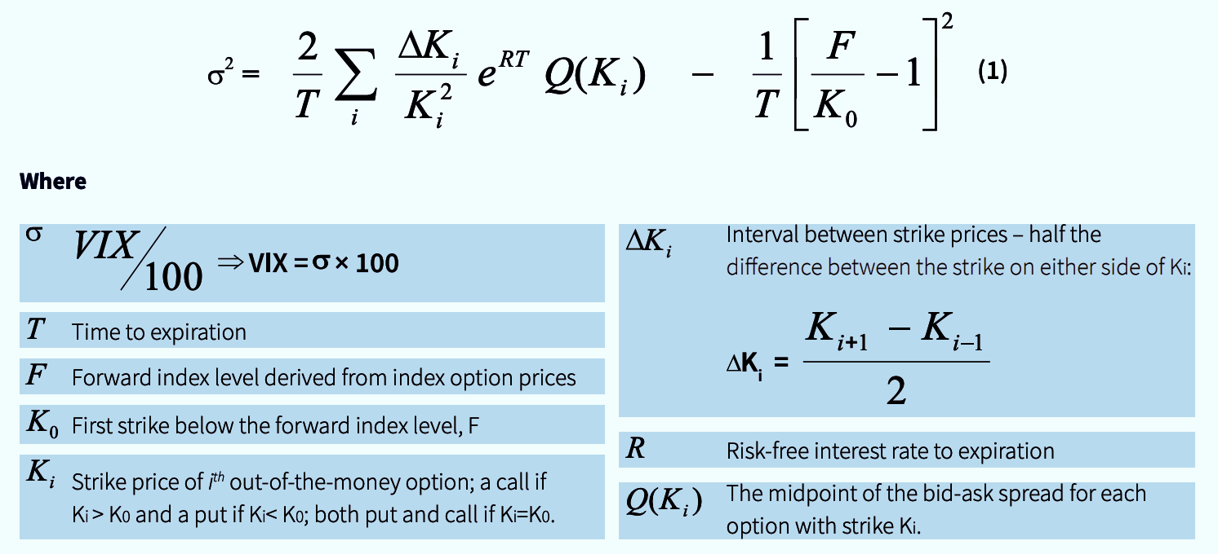
About the Data
VIX is the foremost indicator of stock market volatility and investor sentiment. It is a measure of the market’s expectation of near term volatility of the prices of S&P 500 stock index options.

Slide 4
Business Understanding
We use both classification model and regression models to predict percentage change of VIX, and we use xgboost to out perform the linear models
Baseline
Linear Regression: MSE 0.051
Base Distribution: 0.53
Expected Value added
Boosted regression tree: MSE 0.0369
Boosted classification tree: Accuracy 0.55

Slide 5
About the Predictors
Ave sources:
It’s the average number of information sources containing one or more mentions of an event.
Goldstein:
It ranges from -10 to 10, capturing the potential impact of that type of event will have on the stability of a country.
Numarticles:
It’s the total number of source documents containing one or more mentions of this event during the 15 minute update in which it was first seen. It can assess the “importance” of an event.
Avg Tone:
It’s the average “tone” of all documents containing one or more mentions of this. It’s a subtle measure of the importance of an event and ranges from -100(extreme negative) to 100 (extreme positive )
Quad Class:
1: The event is under verbal cooperation.
2: The event is under material cooperation.
3: The event is under verbal conflict.
4: The event is under material cooperation.

Slide 6
Data Processing
Our sentiment data comes from Google big query and VIX is from Yahoo Finance.
1
4
Aggregate each feature by daily average.
We used SQL to extract event data that happened in the US between Jan 1 2015 and Feb 2019.
2
We took average of all previous days for non trading days.
5
3
One hot encode quad class into 4 binary categorical features.

Slide 7
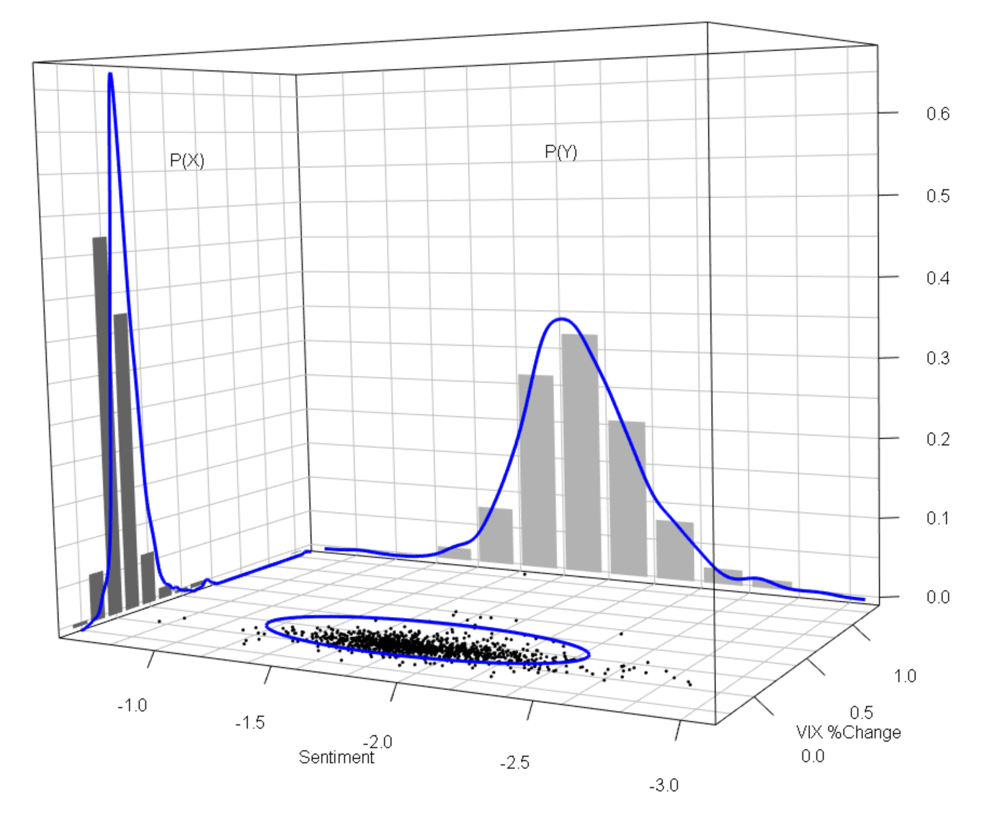
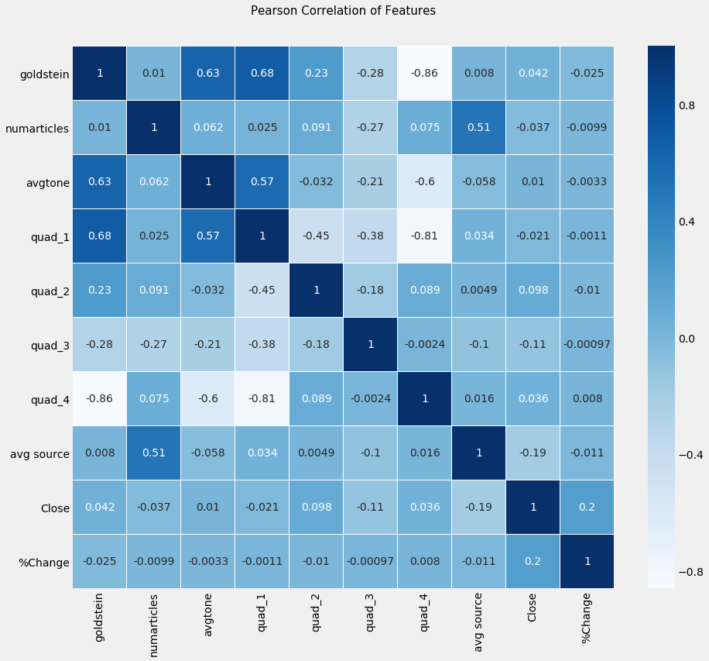
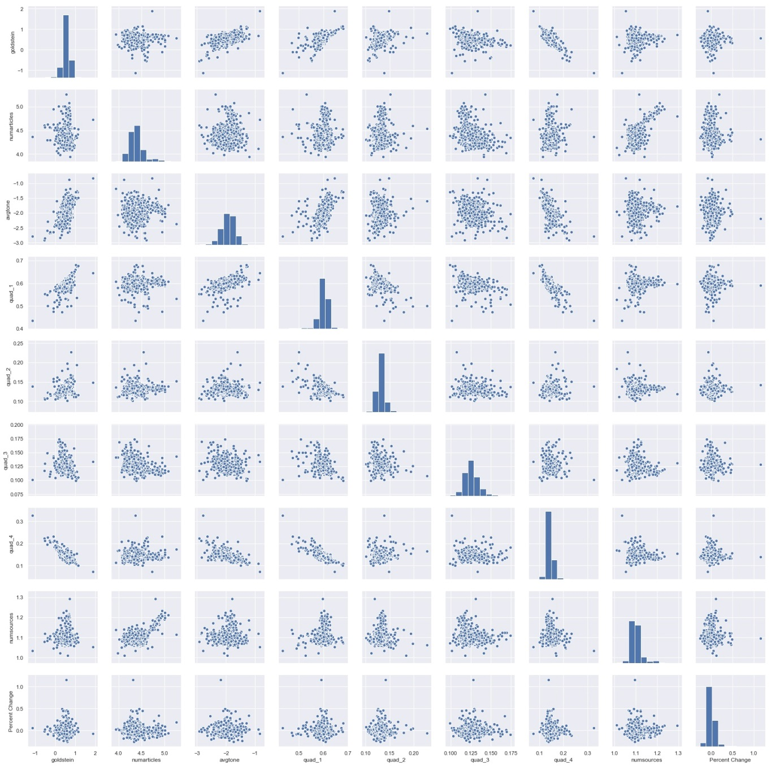
Exploratory Data Analysis

Slide 8
Quantitative Model
Qualitative Model
Regression
Classification
Y: Percentage Change of VIX
Model:
Linear Regression
Boosted Tree Regression
Y = 1: If today’s VIX greater or equal to yesterday’s
Y = 0: If today’s VIX smaller than yesterday’s
Model:
Logistic Regression
SVM
Boosted Decision Tree

Slide 9
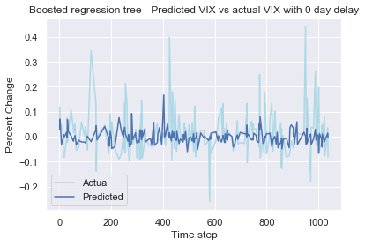
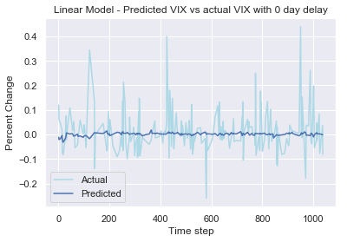
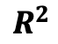
Quantitative Model Analysis
 | Boosted Regression tree | Linear Regression
MSE | 0.0369 | 0.0511
 | 0.0013 | 0.0188
$$R^{2}$$
10 fold cross validation
Parameters : number of trees = 10, max depths of tree = 2, learning rate = 0.1

Slide 10
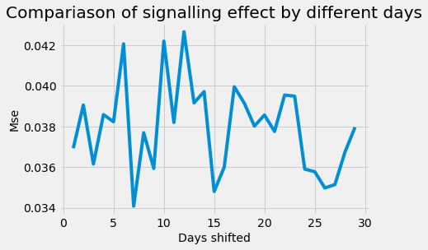
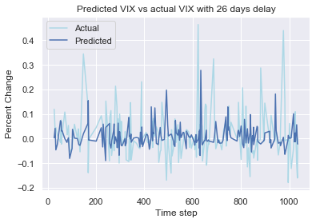
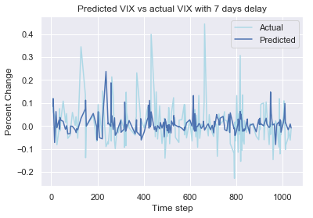
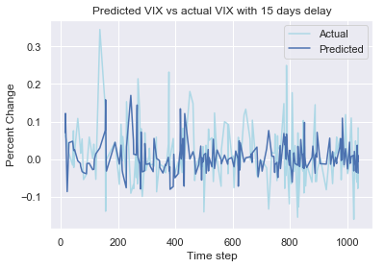
Quantitative Model Analysis
Signalling Value Add
 | no shift | 7-Day | 15-Day | 26-Day
Avg MSE | 0.0369 | 0.0340 | 0.0353 | 0.0349

Slide 11
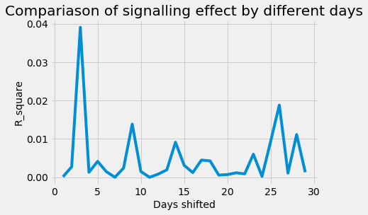
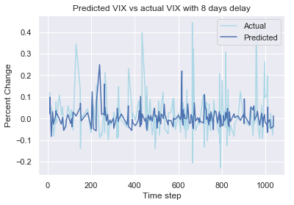
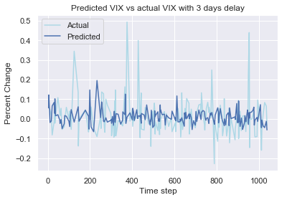
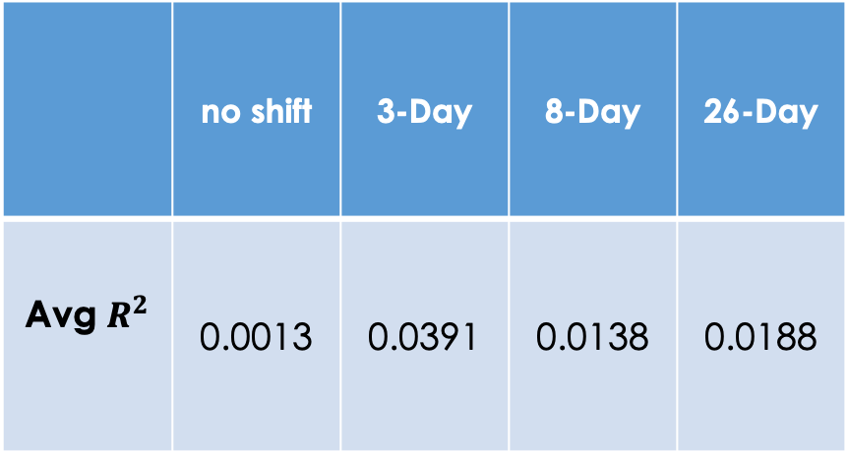
Quantitative Model Analysis
Signaling Value Add
 | no shift | 3-Day | 8-Day | 26-Day
Avg $R^{2}$ | 0.0013 | 0.0391 | 0.0138 | 0.0188

Slide 12
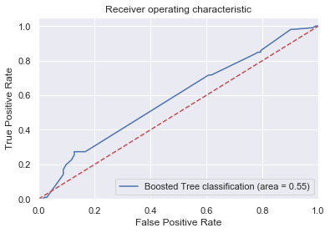
Qualitative Model Analysis
(positive/negative classification)
 | Accuracy | ROC_AUC
Base distribution | 0.53 | 0.50
logistic regression | 0.5144 | 0.5078
boosted tree classification | 0.5508 | 0. 5114
SVM classification | 0.5086 | 0.4997

Slide 13
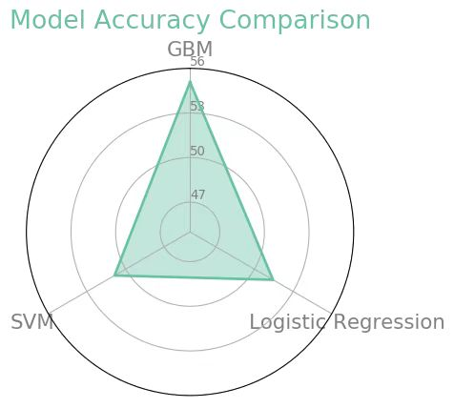
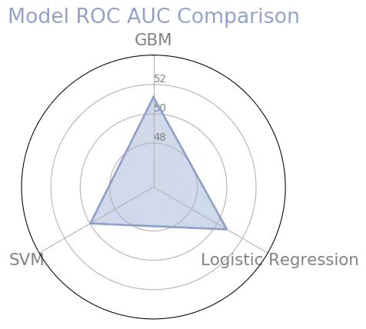
Qualitative Model Comparison

Slide 14
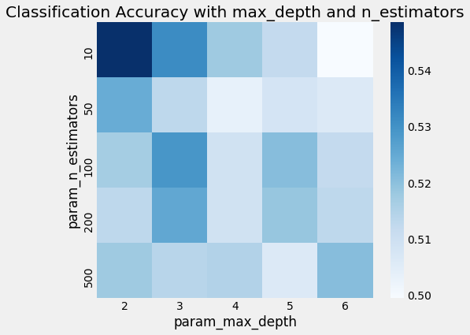
Hyper Parameter Selection-grid Search
The best parameters:
Number of trees: 10
Max depths of tree: 2

Slide 15
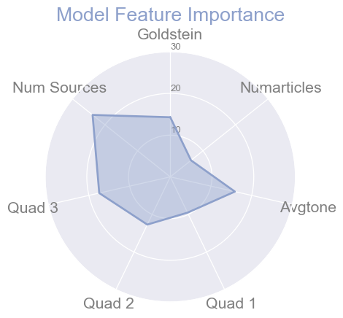
Feature Importance Plot

Slide 16
Summary
The sentiment indeed have effect on predicting the percentage change of VIX.
The model of boosted trees have the best effect accuracy on the classification which is 0.55.
We used grid search to find the best parameters of Xgboost of our model.
We find there exists signaling effect of the sentiment to the VIX, Using the data of sentiment shifted 26 days before VIX have a good predicting power.

Slide 17

Reference
Investopedia CBOE Volatility Index (VIX) Definition https://www.investopedia.com/terms/v/vix.asp
Scikit-learn package from Python https://scikit-learn.org/stable/
Yahoo Finance https://finance.yahoo.com/quote/%5EVIX/
Google big Query https://bigquery.cloud.google.com/table/gdelt-bq:gdeltv2.events?pli=1

Slide 18
THANKS FOR YOU ATTENTION！

